Slide 1

An Improvement of Migration Efficiency in a Distributed Storage System with Dynamic Tiering
Paper review by : Fahim Arshadur Rouf ID: 23273002 Course ID: CSE707
Submission date: 12/11/23

Slide 2

Agenda
Introduction
Migration Strategies in Distributed Storage Systems
System Overview:
Improving Migration Efficiency in Autonomous Distributed Storage Systems
Migration Policies:
Simulation Results

Slide 3

INTRODUCTION
A Brief summary of the paper
Improving migration efficiency in dynamically tiering distributed storage systems is the main focus of this paper. The paper discusses the problem of inefficient data migration processes in large-scale systems with numerous storage nodes. This proposal seeks to improve I/O performance through the implementation of stricter migration regulations. The authors claim that inefficiencies in the migration process are the primary problem, particularly in systems with a high number of storage nodes. The recommended solution advocates for more aggressive migration strategies, with a particular emphasis on higher-performance storage nodes. The expected outcome, according to simulation results, is a significant reduction in I/O execution time. This emphasizes how crucial the recommended technique is for improving the performance of distributed storage systems.[1]

Slide 4
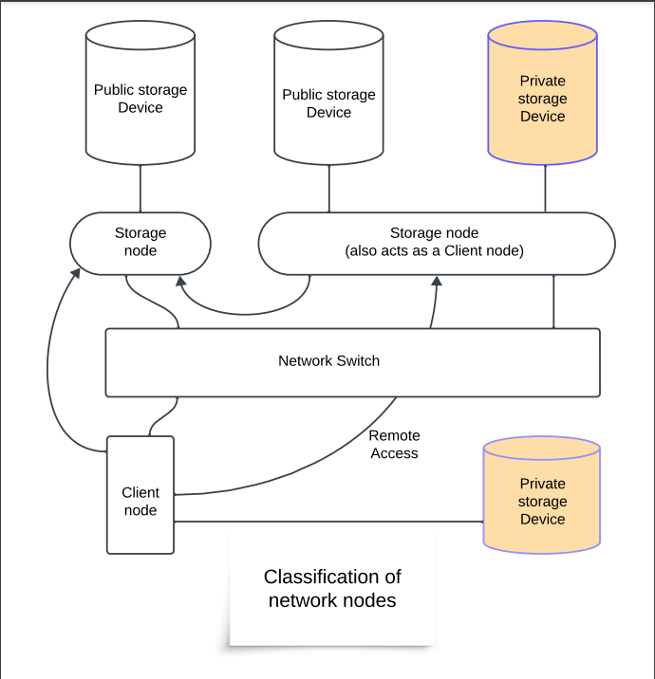
Migration Strategies in Distributed Storage Systems [1]:
Importance of Efficient Migration[1]
In distributed storage systems, avoiding inefficient migration is critical. It reduces network traffic, prevents performance degradation, and maximizes resource use.
Existing Storage Tiering Systems [1]
Storage tiering is used by existing systems such as Easy Tier, FAST, Hystor, and OTF-AST [1]. Nevertheless, they are primarily made for stand-alone storage servers and do not fully account for distributed storage systems' heterogeneity and network overhead.
Proposed Migration Policies [1]
The improved migration policy proposed in this paper selects the middle node in either the upper or lower storage tier as the destination. This policy improves I/O performance by reducing request execution times.
Reference: Figure 1(A. Nunome and H. Hirata, "An Improvement of Migration Efficiency in a Distributed Storage System with Dynamic Tiering," 2019 20th IEEE/ACIS International Conference on Software Engineering, Artificial Intelligence, Networking and Parallel/Distributed Computing (SNPD), Toyama, Japan, 2019, pp. 455-460, doi: 10.1109/SNPD.2019.8935656.)

Slide 5
System Overview:
System Heterogeneity:
The system changes the location of data blocks based on network node access patterns, as well as its hardware configuration and I/O workload. [1]
Network Node Classification:
The system divides network nodes into two categories: storage nodes and client nodes. Client nodes can remotely mount and access the public storage area provided by storage nodes. [1]
Storage Information Exchange:
To communicate the state of storage nodes, including throughput and available space, the system employs a tiny data structure known as storage information. Storage information is appended to iSCSI packets to reduce network overhead. [1]
Storage Tiering:
The system determines the unified performance of the storage nodes by combining reading and writing performance, which is then used to rank and stratify them. The system moves data blocks to the upper or lower storage tier based on the amount of available space and the frequency of access. [1]

Slide 6

Improving Migration Efficiency in Autonomous Distributed Storage Systems: [1]
Node Classification:
Network nodes are classified into two types: storage nodes and client nodes [1].
Storage nodes have a public storage area, and client nodes remotely mount that storage area [1].
Storage Information:
Each storage node periodically exchanges its current status using a data structure called storage information [1].
This includes available storage space and effective throughput [1].
Storage Ranking:
Storage nodes are ranked based on their effective performance [1].
This ranking is used to stratify the nodes into storage tiers [1].
Migration Policies:
The system uses dynamic tiering and migration policies to optimize data block location [1].
This includes original and enhanced migration policies, which balance data concentration and migration efficiency [1].

Slide 7
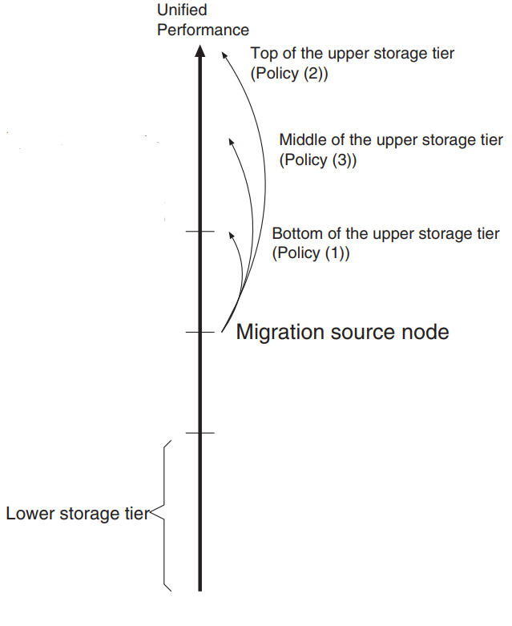

Migration Policies:
Original Migration Strategy: To avoid concentrating frequently accessed data blocks on one storage node, the data block migration is carried out cautiously. This could, however, slow down the rate at which the migrated data blocks spread.
Enhanced Migration Policies: Three policies are proposed for migrating a data block to the upper storage tier:
Policy (1): The initial policy designates the destination as either the topmost storage node in the lower storage tier or the lowest storage node in the upper storage tier. This policy permits a high degree of data migration dispersion..
Policy (2): The most forceful approach to data migration. The top storage node in the upper storage tier is selected as the destination when a storage node migrates a data block there.
Policy (3): A lenient approach. The middle storage node in either the upper or lower storage tier is selected as the destination by the migration source node. This policy strikes a balance between reducing data concentration and increasing migration efficiency..
Reference: Figure 4(A. Nunome and H. Hirata, "An Improvement of Migration Efficiency in a Distributed Storage System with Dynamic Tiering," 2019 20th IEEE/ACIS International Conference on Software Engineering, Artificial Intelligence, Networking and Parallel/Distributed Computing (SNPD), Toyama, Japan, 2019, pp. 455-460, doi: 10.1109/SNPD.2019.8935656.)

Slide 8

Simulation Results [1]
Key Simulation Results:
The execution time using Policy (3) is consistently shorter than the execution time using Policy (2) in all cases. [1]
The maximum improvement in execution time reached 31.5% in certain conditions. [1]
Policy (3) consistently achieved performance improvement in most cases, not only in large systems. [1]
Performance Comparison across Conditions and Policies :
In conditions where the number of client nodes is relatively small, the execution time is reduced by less than one-fifth using enhanced migration policies.
In conditions where the number of client nodes is low, Policy (2) had a more harmful effect on execution time compared to Policy (1). [1]
In conditions where the number of client nodes is large compared to the number of storage nodes, the enhanced migration policies effectively reduced the execution time. [1]
The performance improvements by the enhanced migration policies declined overall, especially in certain conditions where the reduction in execution time was only under 10%. [1]
Superiority of Policy (3):
Policy (3) consistently achieved shorter execution times compared to Policy (2) in all cases. [1]
The improvement in execution time using Policy (3) was remarkable, reaching a maximum improvement of 31.5% in certain conditions. [1]
Policy (3) can achieve consistent performance improvement in most cases, not only in large systems [1].

Slide 9
Thank you
Reference:
[1] A. Nunome and H. Hirata, "An Improvement of Migration Efficiency in a Distributed Storage System with Dynamic Tiering," 2019 20th IEEE/ACIS International Conference on Software Engineering, Artificial Intelligence, Networking and Parallel/Distributed Computing (SNPD), Toyama, Japan, 2019, pp. 455-460, doi: 10.1109/SNPD.2019.8935656

